Slide 1
MATLAB Programming
Midterm Two
Instructor: 黃世強 (Sai-Keung Wong)
TAs: 黃建洲, 蔡承恩, 林柏全

Slide 2
Templates
If there are templates in the folder, you can use it (them) or you can write on your own.

Slide 3
Content
There are four questions. You must answer all of them.
Each program must be interactive. Deduct 5pt if the program is too slow to run.

Slide 4
About demo video/figure
A demo video/figure may have bugs. The demo video/figure shows roughly the results. These results may not be exactly the same as the requirements. They are for your own reference. You must follow the instruction to finish your programs.

Slide 5
Program file name format
Write all your programs in a folder. The folder name is mat_midterm02_student_ID. For example, if your ID is 12345678, the folder name is mat_midterm02_12345678.
Zip the folder and upload it.
Write a program for each problem in one file.
The file name is m02_X_yourStudentID.m, where X is the problem number.
For example, if your student ID is 12345678 and the problem number is 3, then the file name must be m02_3_12345678.m.
You must not output all the intermediate results.
Output the results that are required only.

Slide 6
File content header
At the top of the file, write down your name, ID, email address, department, and date.
%%%%%%%%%%%%%%%%%%%%%%%%%%%
% Midterm Number: …
% Problem number: …
% Student Name: …
% Student ID: …
% Email address: …
% Department:
% Date: ….
%%%%%%%%%%%%%%%%%%%%%%%%%%%%

Slide 7
File content
For each problem, display the problem number before showing the results.
close all; clear; clc; % close all windows
% clear variables, and clear screen
disp('Midterm Problem 2.1') % show Midterm Problem 2.1

Slide 8
(25pt) Problem 2.1. Curve Animation
There is one curve. Implement a program to manipulate the curve in two different methods: (1) erase the curve interactively and (2) draw it interactively.
Furthermore, the drawing speed and erasing speed may not be the same. Set the curve line width to 3. Use subplot to visualize the results in two different formats:
1) horizontal 2) vertical
Polar Curve: r = cos(4x)sin(2x). Let X be the interval of x. X =[-π:0.02:π].
Let di and dj be the increment values for the indices when the curve is erased and drawn, respectively.
Method one: Erase the curve interactively. A point is drawn as a circle to erase the curve. The curve color is [0.0, 0.0, 0.7]. Use di as the curve erasing speed. At the end, the curve must be erased completely.
Method two: Draw the curve interactively. The new point is drawn as a circle. The curve color is [0.7, 0.3, 0.0]. Use dj as the drawing speed. At the end, the curve must be completely drawn.

Slide 9
Problem 2.1.
Procedure:
0. Show the student ID and name. If you do not do this, your score is zero.
1. Ask the user to input the layout of the subplots: (1) horizontal (2) vertical. E.g., input 1 for horizontal and 2 for vertical.
2.Ask to input di and dj as an array format. For example, input [1 3] for di = 1 and dj =3, respectively.
3.Produce the animation based on the layout in an interactive manner.
4.Set the curve line width to 3.
You can produce the curves on the Cartesian space or polar space.
Note that di and dj must be inside [1, 10]. For a higher value of di and dj, the curve erasing speed and drawing speed must be faster, respectively.
You can use the following code to get the plot handle; and use the handle p to set the line width and color of a curve.
p = polar(…);
p.LineWidth = 3;
p.Color = [0.7, 0.3, 0.0];

Slide 10
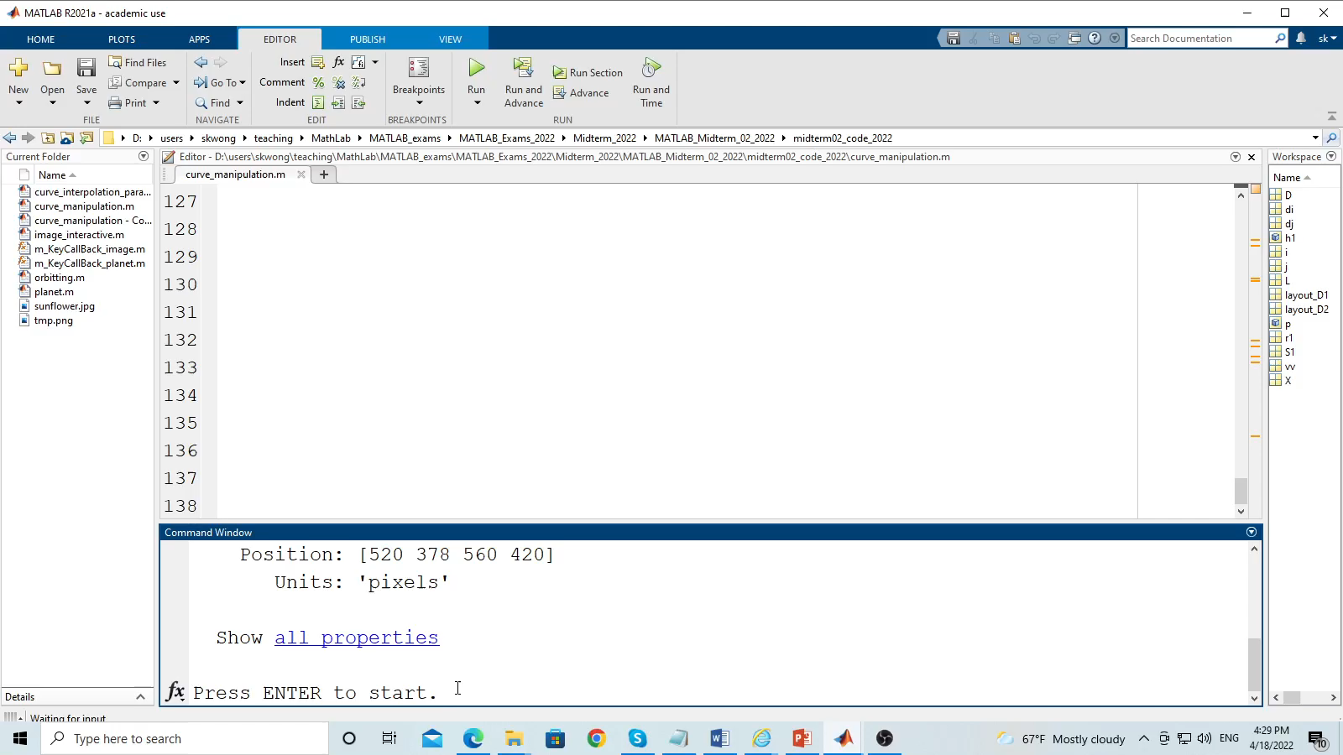
Horizontal layout
Erasing
Drawing
Play to see the animation.

Slide 11

Vertical layout
Play to see the animation.
Erasing
Drawing

Slide 12
Problem 2.1 Marking scheme
Penalty: Show the student ID and name. If you do not do this, your score is zero.
[1pt] Ask to input the layout.
[1pt] Ask to input di and dj
[8pt] The first curve is erased interactively and correctly.
[7pt] The Second curve is drawn interactively and correctly.
[5pt] The erasing speed and drawing speed are handled correctly.
[3pt] The two layouts (horizontal and vertical) are corrected.

Slide 13
(25pt) Problem 2.2. Curve interpolation and extrapolation
Given two parametric functions: Function 1 (Epitrochoid) x1(t) = (a1+b1) * cos(t) – c1 * cos( (a1/b1+1)*t ); y1(t) = (a1+b1) * sin(t) – c1 * sin( (a1/b1+1)*t ); 0 <= t <= 4 π a1 = 9; b1 =3; c1 = 8 t is the independent variable. | Function 2 (Rhodonea Curve) x2(t) = a2 * cos(t) * sin(d2*t); y2(t) = a2 * sin(t) * sin(d2*t); a2= 10; d2 =2 0 <= t < = 8 π
Use axis([-25 20 -20 20]) to set the axis limits.
Notice that the ranges of t for the two curves are not same. You must compute the correct step size of t so that the number of sample points are the same for both curves.
Example:
For function 1, you must use t = [0:0.1:4π].
For function 2, you must use t = [0:0.2:8π].

Slide 14
(25pt) Problem 2.2. Curve interpolation and extrapolation
We can interpolate the two functions as follows:
x(t) = (1-k) x1(t) + k x2(t)
y(t) = (1-k) y1(t) + k y2(t)
k can be computed in two methods. Thus, we produce the animation process to interpolate the two functions in two plots. Let f = 0:0.025:1. The two methods are:
(Left) k = 1-cos(f*π/2), and (Right) k = f*(2 - sin( (1-f/2) *π + 2*f*π ) ).
Apply the first way to the left plot and the second way to the right plot.
Ask to press ENTER before the animation is generated. The animation result must be similar to the example. There must be two plots (use subplots). Each plot shows one interpolation result. The animation must be smooth and interactive. Make sure that the figure window is on top.

Slide 15
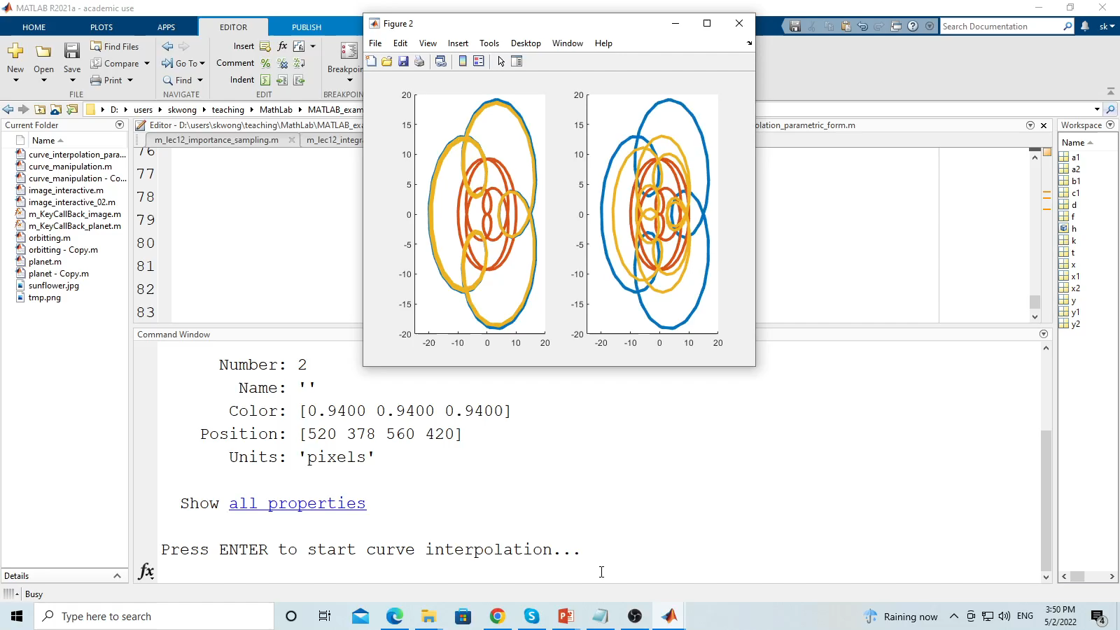
Problem 2.2
Play to see the animation.

Slide 16
Problem 2.2 Marking scheme
[7pt] The interpolation is correct in the first plot.
[7pt] The interpolation is correct in the second plot.
[5pt] The animation is smooth and interactive.
[5pt] The curves are correct and the colors of the curves are appropriate. All the curves can be seen clearly.
[1pt] The axis limits are correct.

Slide 17
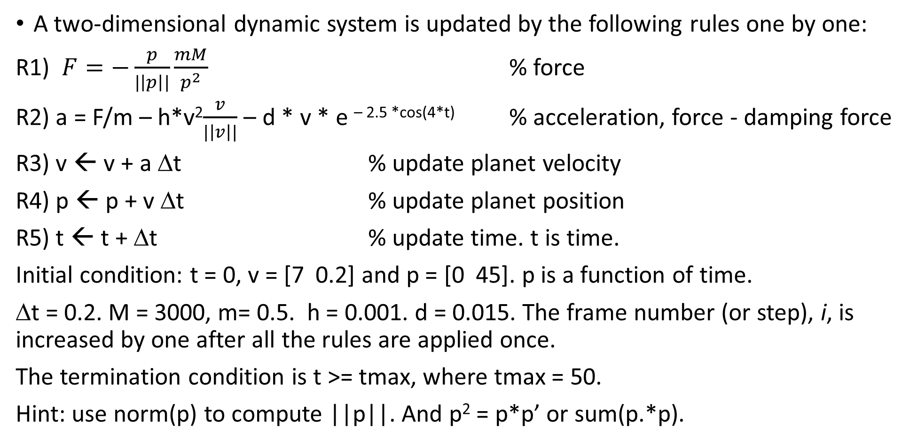
(25pt) Problem 2.3. Planet
A two-dimensional dynamic system is updated by the following rules one by one:
R1) $F=−\frac{p}{|\left|p\right||}\frac{mM}{p^{2}}$ % force
R2) a = F/m – h*v²$\frac{v}{|\left|v\right||}$ – d * v * e ^{– 2.5 *cos(4*t)} % acceleration, force - damping force
R3) v ← v + a Δt % update planet velocity
R4) p ← p + v Δt % update planet position
R5) t ← t + Δt % update time. t is time.
Initial condition: t = 0, v = [7 0.2] and p = [0 45]. p is a function of time.
Δt = 0.2. M = 3000, m= 0.5. h = 0.001. d = 0.015. The frame number (or step), i, is increased by one after all the rules are applied once.
The termination condition is t >= tmax, where tmax = 50.
Hint: use norm(p) to compute ||p||. And p² = p*p’ or sum(p.*p).

Slide 18
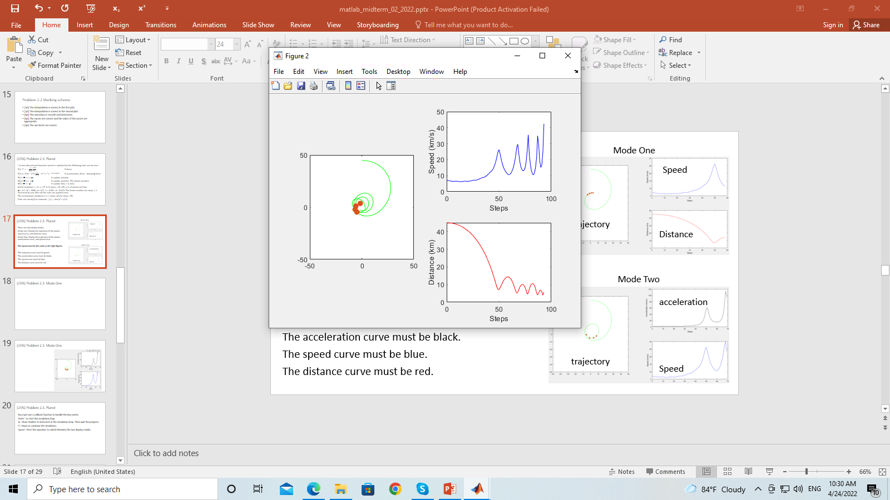
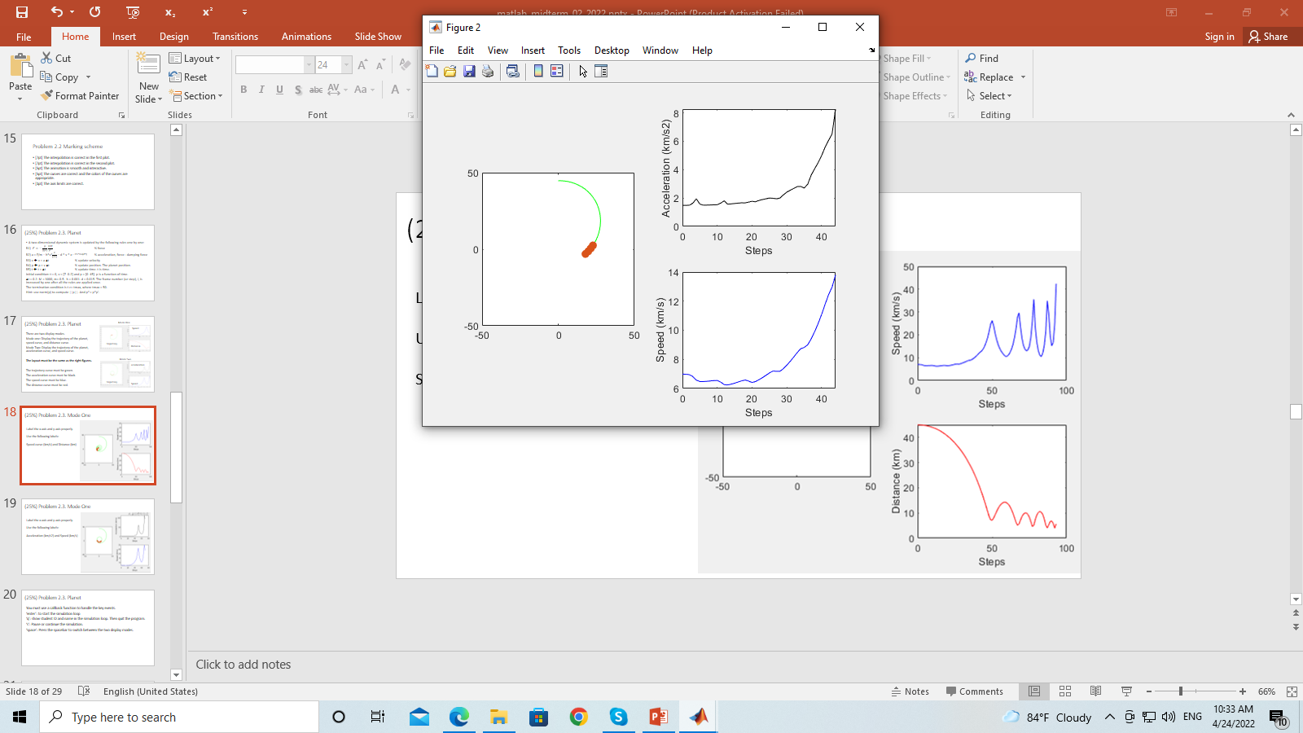
Problem 2.3. Display modes
Mode One
Speed
The figure window must be set on top of all other windows.
There are two display modes.
Mode One: Display the trajectory curve of the planet,
speed curve, and distance curve.
Mode Two: Display the trajectory curve of the planet, acceleration curve, and speed curve.
The layout must be the same as the right figures.
The trajectory curve must be green.
The acceleration curve must be black.
The speed curve must be blue.
The distance curve must be red.
trajectory
Distance
Mode Two
acceleration
trajectory
Speed

Slide 19
Problem 2.3. Mode One
Label the x-axis and y-axis properly.
Use the following labels:
Speed curve (km/s) and Distance (km)
The x-axis refers to the number of simulation time steps.

Slide 20
Problem 2.3. Mode Two
Label the x-axis and y-axis properly.
Use the following labels:
Acceleration (km/s2) and Speed (km/s).
The x-axis refers to the number of simulation time steps.

Slide 21
Problem 2.3. Planet
You must use a callback function to handle the key events.
Key | Purpose
‘enter’ | Enter the simulation loop. After that, it is not used.
‘q’ | Show student ID and name on the console window. Then quit the program
‘s’ | Pause or continue the simulation
‘space’ | Press the spacebar to switch between the two display modes (mode switching)

Slide 22
Key events
You can use the following code for your solution.
function m_KeyCallBack_planet(src,event)
disp(event.Key);
global key_pressed_quit;
global key_pressed_enter;
global key_pressed_mode;
global key_pressed_stop;
switch(event.Key)
case 'return'
…
case 'q'
…
case 's'
…
case 'space‘
key_pressed_mode = ~key_pressed_mode;
otherwise
end
end
global key_pressed_quit;
global key_pressed_mode;
global key_pressed_enter;
global key_pressed_stop;
key_pressed_enter = false;
key_pressed_stop = false;
key_pressed_mode = true;
key_pressed_quit = false;

Slide 23
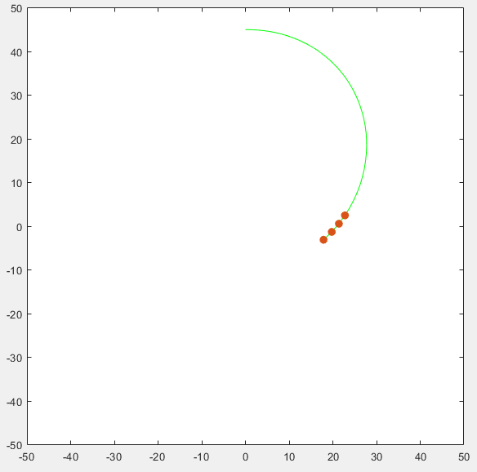
Problem 2.3
Draw the trajectory of the planet. The planet must be rotating around the origin (0,0) at the beginning.
Must use
axis( [-50 50 -50 50] );
pbaspect( [1 1 1] ).
Draw N recent sample points of the trajectory of the planet. The N points must be drawn clearly. Use markers to draw the points. Set the marker size as 25.
Here, N is 4.

Slide 24
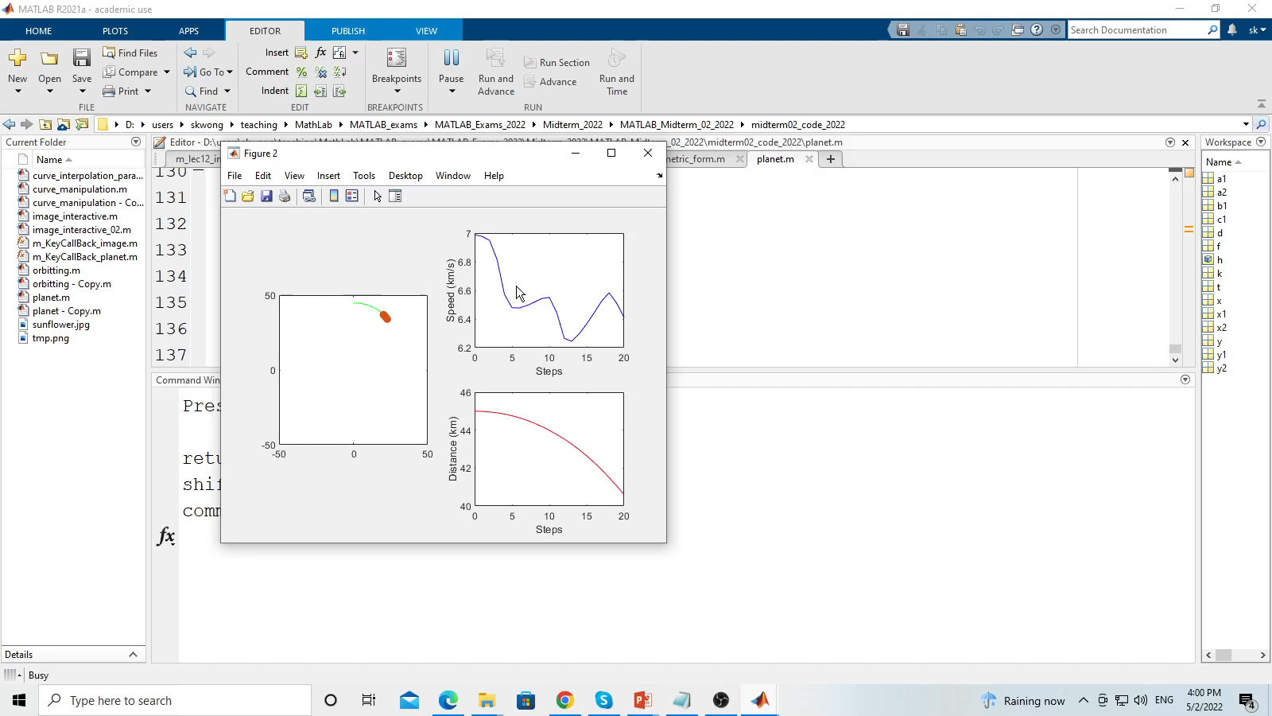
Problem 2.3
Play to see the animation.

Slide 25
(25pt) Problem 2.3. Marking scheme
Mode One
Speed
[2pt] The trajectory curve of the planet is correct.
[1pt] The most recent four points are shown clearly.
[2+1+1pt] The acceleration curve is correct. Its color is black. The labels are correct.
[2+1+1pt] The speed curve is correct. Its color is blue. The labels are correct.
[2+1+1pt] The distance curve is correct. Its color is red. The labels are correct.
[3+1pt] The four curves are correct and the performance of the program must be interactive.
[3pt] The two display modes can be switched correctly by pressing the spacebar.
[3pt] All the four key events are handled correctly at any time (enter, pause, quit, mode switching).
Deduct 5 points if the layout of the plots is incorrect.
trajectory
Distance
Mode Two
acceleration
trajectory
Speed

Slide 26
(25 pt) Problem 2.4. Image manipulation
This program manipulates the image, tmp.png.
Resize the image dimension to [640 640].
You must press keys to manipulate the image.
The results must be similar to the results in the demo video.
The effect can be accumulated or not for the operations.

Slide 27
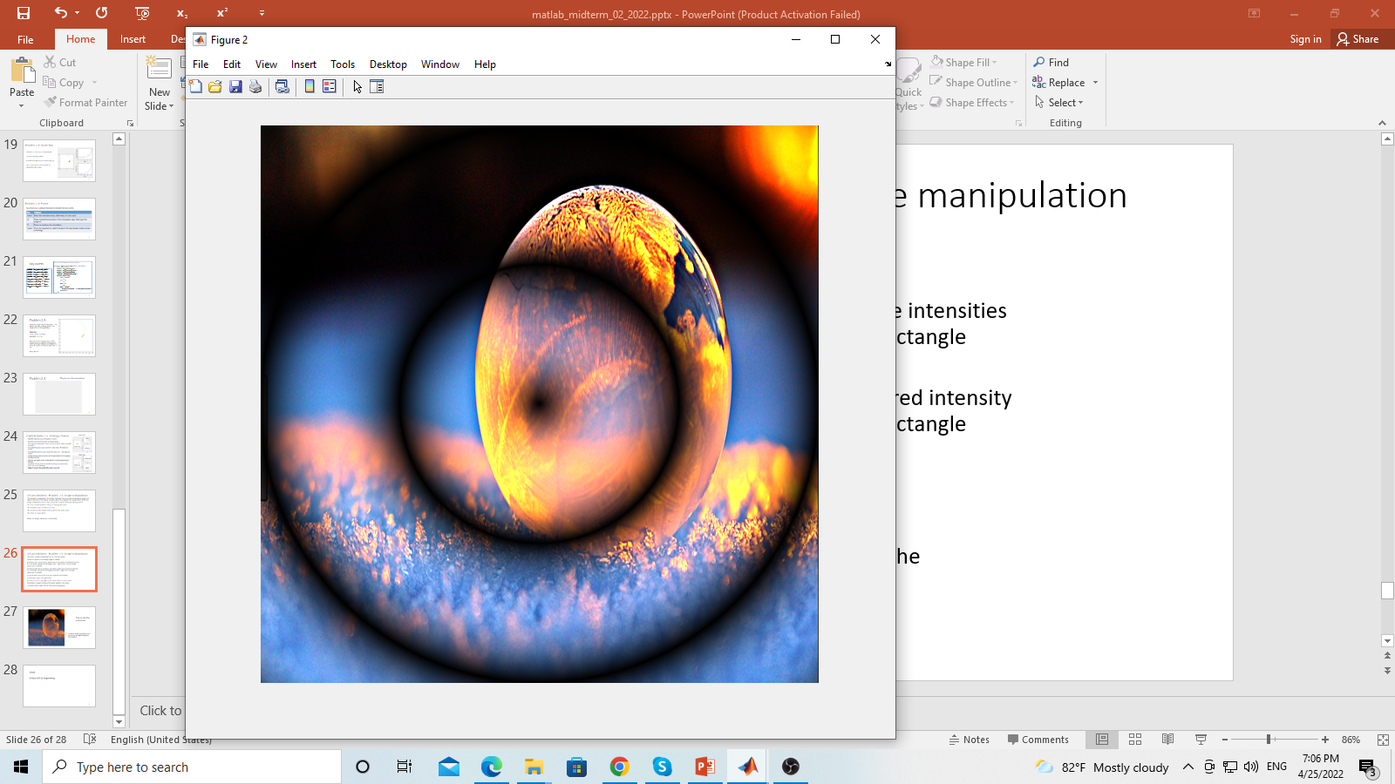
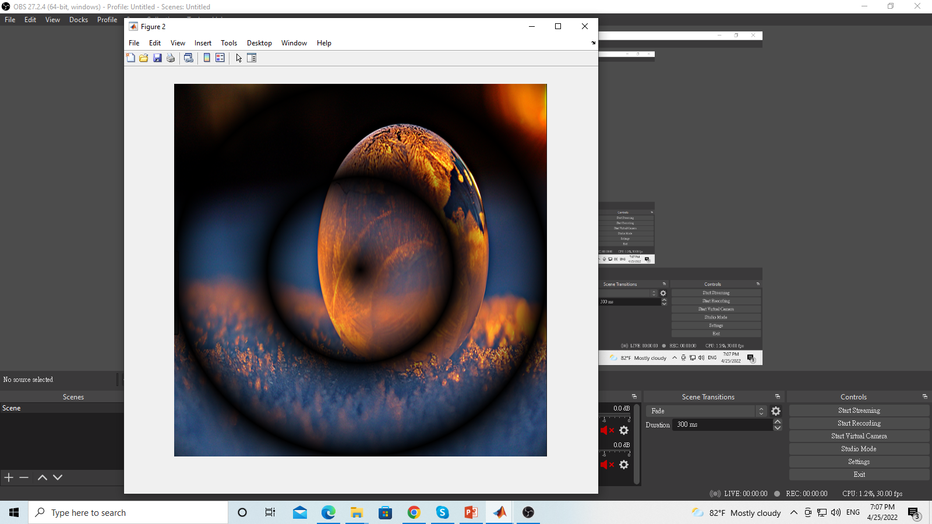
(25 pt) Problem 2.4. Image manipulation
The effect can be accumulated or not. You can decide.
Show the key usage for the six options:
q) Show student name and ID. Then quit the program. You must do this item. If not, your score is zero.
j) Enhance the red intensity while reduce the green and blue intensities in a rectangle. Sweep the rectangle from right to left. The rectangle dimension is 320x80. After the process, the entire image should be modified correctly.
k) Enhance the green and blue intensities while reduce the red intensity in a rectangle. Sweep the rectangle from left to right. The rectangle dimension is 320x80. After the process, the entire image should be modified correctly.
n) Show white vertical lines. At least 6 white vertical lines.
m) Change to gray color gradually, i.e., an animation.
b) Turn on or off a spot light on the center. Raise or reduce the intensities of pixels. Produce the result similar to the demo.
(b) Turn on
(b) Turn off

Slide 28
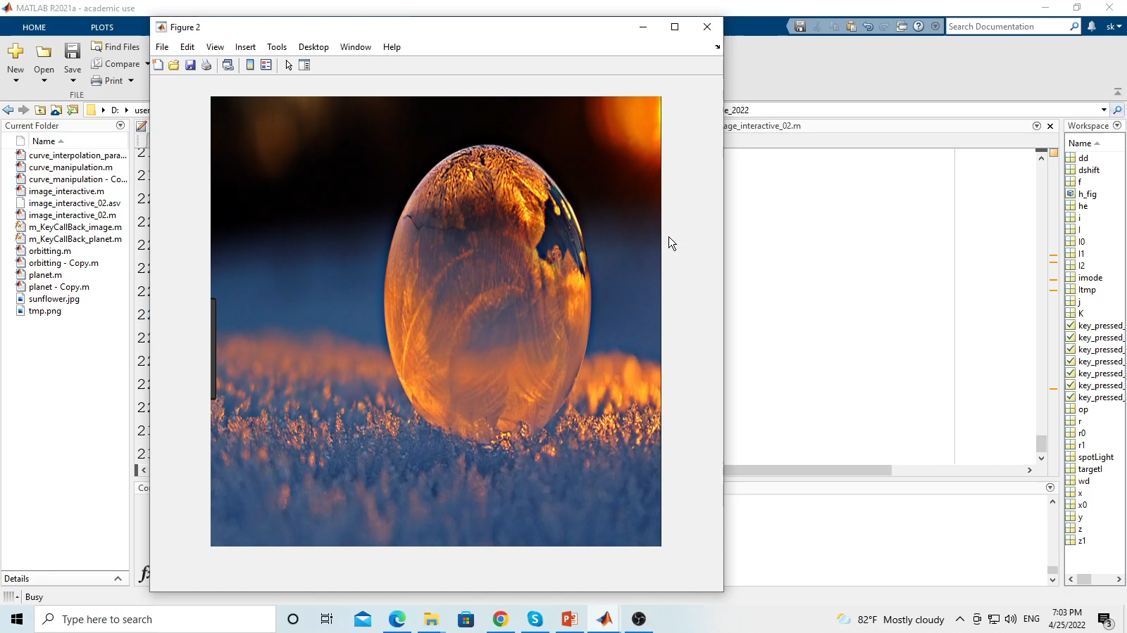
Play to see the animation.
The effect can be accumulated or not. You can use the original image and then modify it for each operation.

Slide 29
(25 pt) Problem 2.4. Marking Scheme
[1pt] q) Show student name and ID. Then quit the program. You must do this item. If not, your score is zero.
[1pt] Show the key usage for all the six options on the console window.
[5pt] j) Enhance the red intensity while reduce the green and blue intensities in a rectangle. Sweep the rectangle from right to left. The rectangle dimension is 320x80. After the process, the entire image should be modified correctly.
[5pt] k) Enhance the green and blue intensities while reduce the red intensity in a rectangle. Sweep the rectangle from left to right. The rectangle dimension is 320x80. After the process, the entire image should be modified correctly.
[5pt] n) Show white vertical lines. At least 6 white vertical lines.
[4pt] m) Change to gray color gradually. Must be an animation.
[4pt] b) Turn on or off a spot light on the center. Raise or reduce the intensities of pixels. Produce the result similar to the demo.

Slide 30
End
Enjoy MATLAB Programming.

